Slide 1
Design and Development of Two Student-Assisted Research Studies
Dr. Michael Tims

Slide 2
Are You Curious About…
How bicycles work?
Why there lefties (and righties)?
Why yawning contagious?

Slide 3
What We Will Cover
Before you begin
Two projects – challenges and outcomes
Best practices – faculty and students

Slide 4
Before You Begin
Articulate the rationale for your project
Identify collaborators – both internal and external
Design research methods – accept that they will change
How will you collect data?

Slide 5
Lavender Project
Partners
Andrew Pengelly
Krista Lamoreaux
Dr. Art Tucker, Research Professor Emeritus, Delaware State University
American Herbal Pharmacopeia (AHP)
Refine macroscopic method, developed by Dr. Tucker, to identify adulterants of lavender (Lavandula angustifolia)
Macroscopy Textbook, being published by the AHP, similar in concept to their previous publication, Microscopic Characterization of Botanical Medicine

Slide 6
Lavandula angustifolia
(lavender)

Slide 7
Lavandula latifolia
(spike)
Lavandula x intermedia
(lavandin)

Slide 8
Method: Macroscopy
1 Bracts ovate-rhombic
2 Bract length/width ratio 0.83-2.20; bracteoles absent or up to 2.5mm long; flowering early June: L. angustifolia
2a Bract length/width ratio 1.33-3.00; bracteoles 1-4mm long; flowering July: L. x intermedia
1a Bracts linear to lanceolate; bract length/width ratio 4.67-7.0; bracteoles 1-6 mm long; flowering late July-August: L. latifolia
Tucker, AO, & Hensen, KJW. (1985). The cultivars of lavender and lavandin (Labiateae). Baileya 22, 168-177.

Slide 9
Equipment

Slide 10
First Year Challenges
Alumni lead process, working with QA students:
Biology sometimes refuses to cooperate
L. angustifolia (lavender) ratio 0.83-2.20; bracteoles absent or up to 2.5mm
L. x intermedia (lavandin) ratio 1.33-3.00; bracteoles 1-4mm
Panelist unsure of orientation and appearance of complete bract
Supplier cleaned up bracts

Slide 11
Second Year Outcomes
In addition to the AHP collaboration
Developed orthogonal method – sensory analysis to identify adulterants of lavender (Lavandula angustifolia)
Designed appropriate educational process to insure replicability among other QA labs for both methods
Completed data with educational structure to be submitted for peer reviewed publication

Slide 12
Microbiology Project
Partners
Joanne Givens
Nicole Rubin
Marybeth Missenda
Dr. Janie Dubois, Laboratory Program Manager, JIFSAN
Dr. Angela Winslow, Microbiologist, JIFSAN
Detect microbial contamination in Echinacea tinctures
45% alcohol E. purpurea root
60% alcohol E. purpurea seed/aerial, E. angustifolia root
95% alcohol E. purpurea root

Slide 13
Microbiology Project
70% alcohol aseptic technique to kill microbes in labs
Published data lacking whether lower alcohol level solutions also prevent microbial contamination of herbal tinctures
FDA GMP compliance requires addressing this issue
By producing peer reviewed data, smaller herb companies can refer to the published literature when making rationale choices in meeting GMP requirements for microbial contamination of their product.

Slide 14
Equipment
3M Coliform (Aerobic) Count Plate
3M Mold/Yeast Count Plate

Slide 15
Equipment

Slide 16
Results Year One: Pilot
Sample | Dilution | Petrifilm Aerobic Bacteria | Petrifilm Mold | Petri Dish
Dried E. purpurea root | 10⁻¹ | ++ | o | +
Dried E. angustifolia root | 10⁻² | ++ | o | ++
 | 10⁻³ | + | o | +
Dried E. purpurea flower | 10⁻³ | + | o | +
 | 10⁻⁴ | o | o | +
Fresh E. purpurea root | 10⁻³ | +++ | +++ | +++
 | 10⁻⁴ | ++ | ++ | ++
45% EtOH dried E. purpurea root | 10⁻¹ | o | o | o
95% EtOH E. purpurea root | 10⁻¹ | o | o | o
25% EtOH fresh E. purpurea root | 10⁻² | + | o | na
 | 10⁻³ | + | + | +
 | 10⁻⁴ | o | + | o

Slide 17
Microbiology Project: Challenges
Students and alumni both experimenters with JIFSAN personnel training them
More appropriate quantitation
Insure aseptic conditions
Simplify the sample diversity
Improve the training on using aseptic technique

Slide 18
Method: Serial Dilution

Slide 19
Method: Counting Colonies

Slide 20
10⁻² = 1/10²

Slide 21
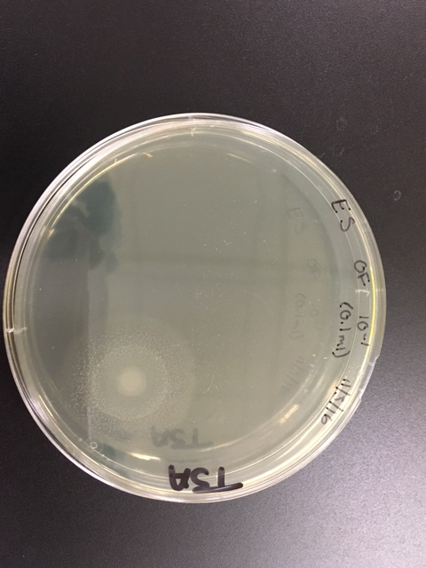
Second Year: Outcomes
Most growth was from the 60% and 95% preparations
All below the countable number >10
3M Mold Plate
Petri Dish General
3M Aerobic Plate

Slide 22
Plans for Third Year
Repeat year two methods in JIFSAN and dispensary
Use a Bunsen burner in the dispensary to create aseptic workspace
Dispensary method mimics needs of small producer

Slide 23
Thoughts on Best Practice: Faculty
Identify real needs in your field, even if they seem small
Include students in project via course or practicum to explore unanswered questions
Include alumni guest lecturers to help develop material

Slide 24
Thoughts on Best Practice: Students
Does the project succeed as an experiment?
What does that mean?
For student projects meet two outcomes
Effective skill acquisition
Building networks
Can we impart Wisdom and what does that look like?

Slide 25
?
Wisdom

Slide 26
Defining Wisdom for Inquiry Based Projects
Love the interesting questions

Slide 27
Choose curiosity over fear

Slide 28
What if There Are No Answers?
How do bicycles work?
Why are there lefties (and righties)?
Why is yawning contagious?
Will your questioning still be fun?

Slide 29
Risk Delight

Slide 30
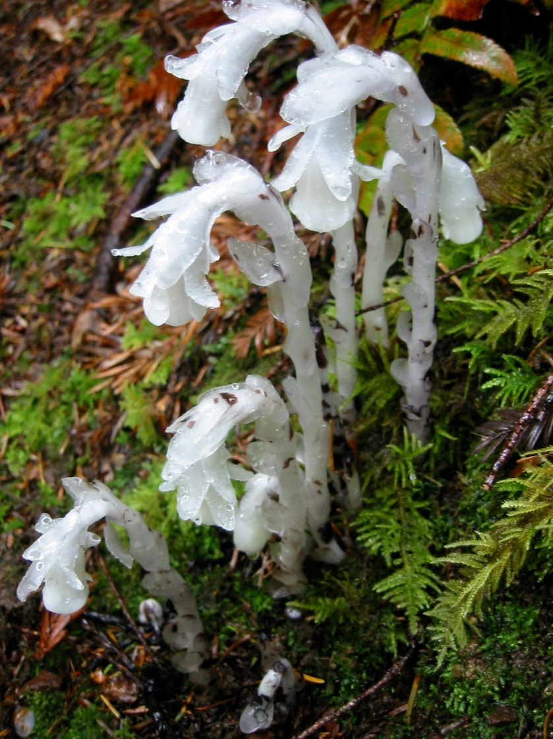
The World You See Is Not Your Own
Ghost Pipe whispers
like blood, edging
taught across the
skin of my temple,
driving faded echoes up
into forest elders
as they burst
into canopy light,
a dense mat of leaf decay
gives way slowly
to something
approximating smoke,
diffuse and ethereal beings
that weave moments
into memory,
unravels story
into that which waits
outside me for her
dusky breath, her
brain stem sway.
Keep this vertical space
alive in your heart,
open to the pulse
of mycelial filament
stretched thin inside
human voice.
Stay connected
Monotropa uniflora

Slide 31
Gratitude
Mentors
Dr. George Bean
Dr. Joseph Betz
Collaborators
Dr. Andrew Pengelly
Dr. Arthur Tucker
Krista Lamoreaux, MS
Joanne Givens, MS
Nicole Rubin, MS
MUIH Community
MUIH Excellence in Research and Scholarship Award Committee
MUIH Herbie team

Slide 32
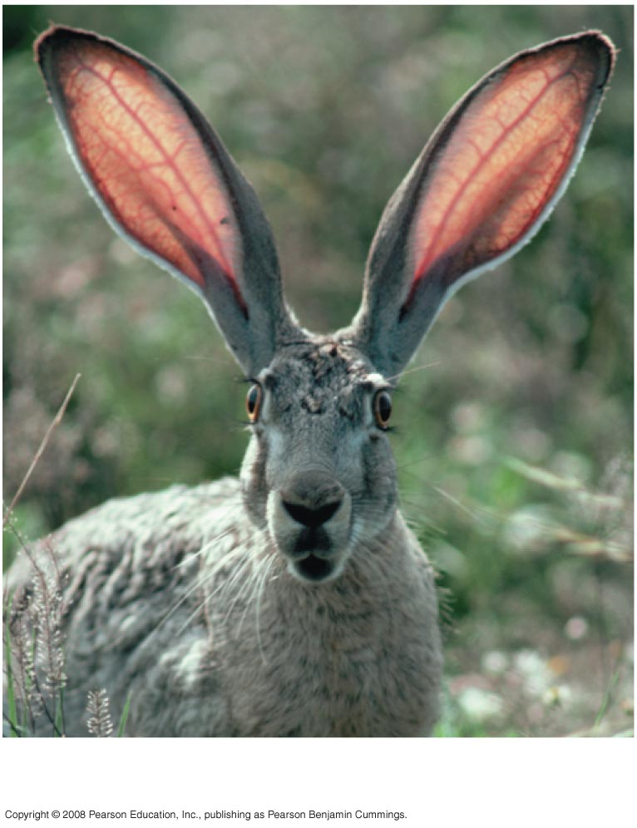
Questions?
Notes:
Figure 1.3 Some properties of life

